Slide 1


Commercial Committee
Lunch & Learn
January 27, 2026

Slide 2

Kaydee Albritton
CPAR CEO

Slide 3



Slide 5


Slide 6

Kurt Fadden
2026 Commercial
Committee Chair

Slide 7

Kurt Fadden
2026 Commercial Committee Chair
Chris Clubbs
Committee Vice-Chair

Slide 8

Thank you to our Sponsor!

Slide 9
Kurt Fadden
2026 Commercial
Committee Chair

Slide 10
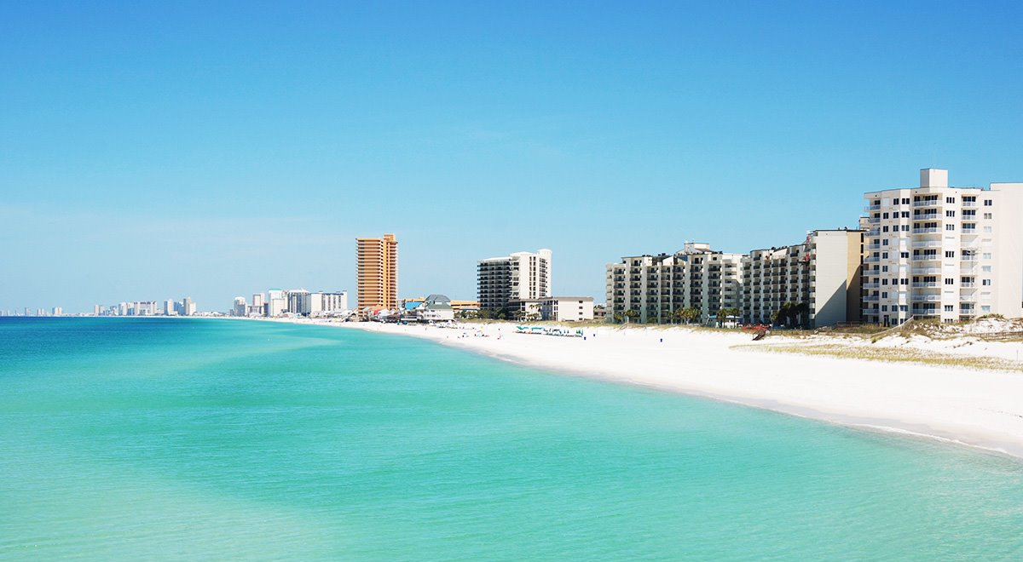

Bay County, FL Overview
CPAR Commercial
January 27th, 2026

Slide 11

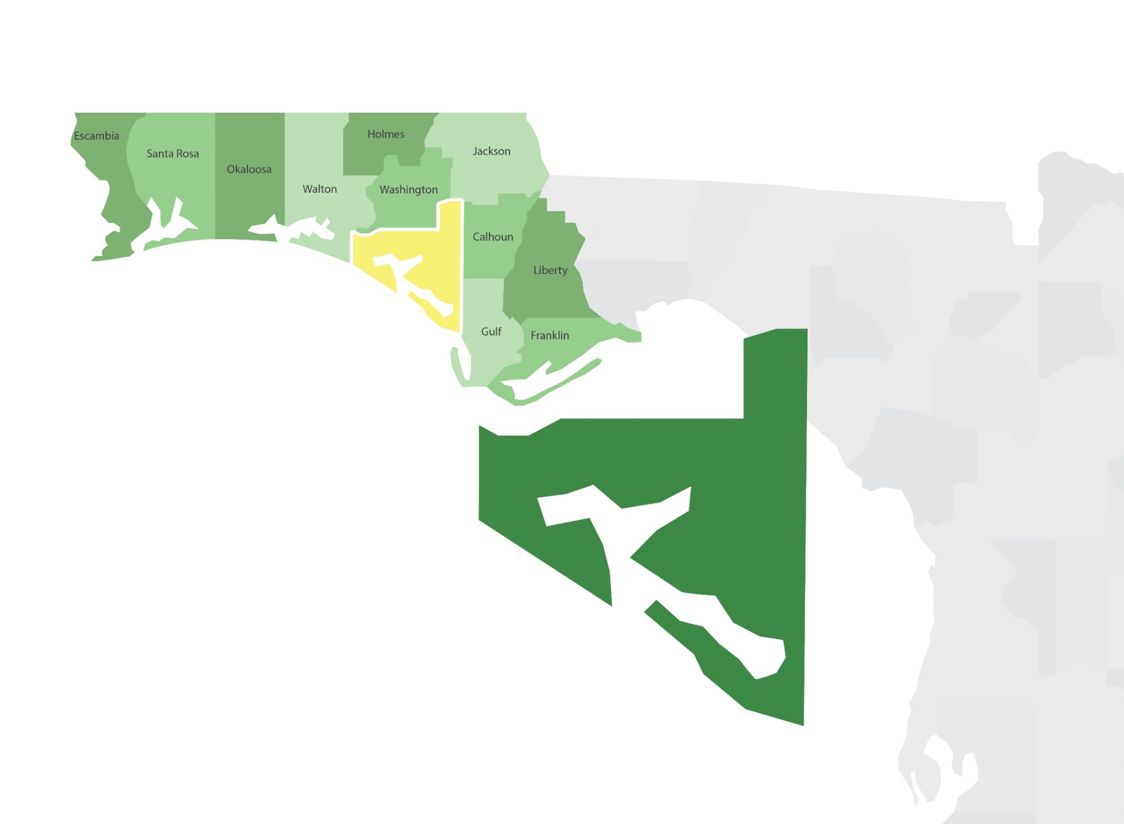
Bay County, Florida
Bay County, FL Overview
BayEDA.com – 850.215.9965

Slide 12
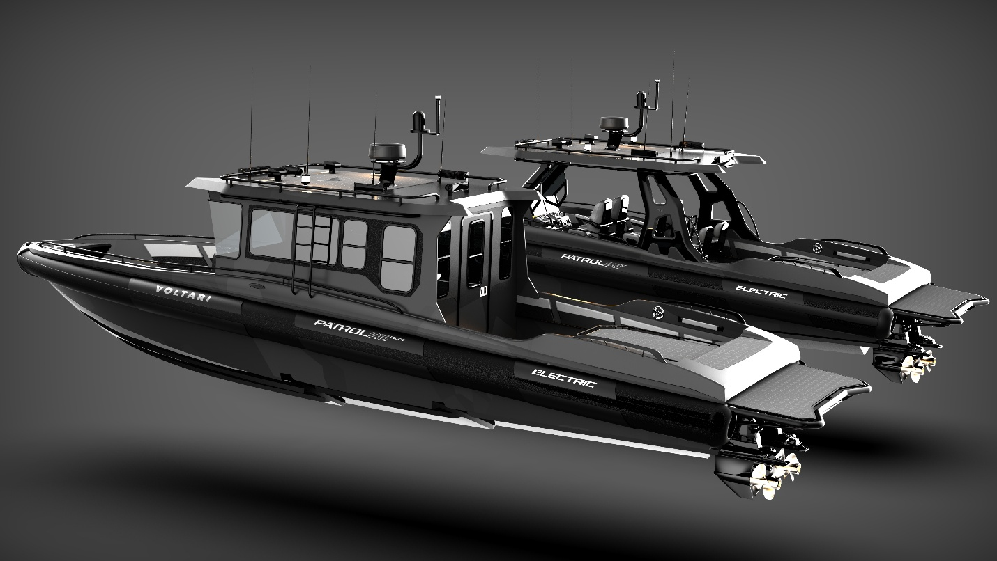


Project Kilowatt – Voltari Electric, Inc.
Bay County, FL Overview
BayEDA.com – 850.215.9965

Slide 13
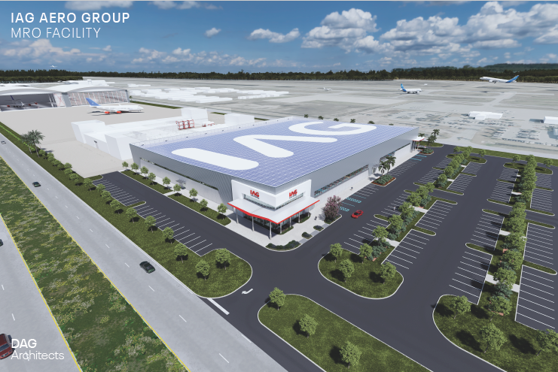

Project Spinner - IAG Aero Group
Bay County, FL Overview
BayEDA.com – 850.215.9965
Notes:
Port Panama City is a growing deep-water port and international gateway, handling a wide variety of cargo, and offers the best shipping connections to Mexico than any other port in the United States. In recent years, the Port has invested over $50 million in new facilities and equipment. Over the next five years, the Port plans to increase its cargo tonnage to an annual level of approximately 2.1 to 2.4 million tons, and has committed to another $35 million in improvements.
Panama City’s location provides a Gulf Coast gateway to shippers and consignees in Georgia, Alabama, Florida, Tennessee and the Carolinas. The Port also serves as trading partners to Mexico, Central America, South America, China, Europe and the Mediterranean. The Port is equipped with modem loading and unloading facilities for truck, rail, barge, container, RO-RO vessel and deep-water vessel traffic.
On-site rail is provided by the Bay Line Railroad, which connects to the Port’s Intermodal Distribution Center, a 240-acre pad-ready inland industrial park featuring a brand new 150,000 square foot distribution warehouse. The Gulf Intracoastal Waterway, a 1,050-mile inland navigable waterway from Carrabelle, FL to Brownsville, TX, is located adjacent to the Port providing access to the Mississippi River and numerous southeastern ports.
Primary General and Bulk Cargos Include:
Forest Products
Copper
Steel
Containerized Cargo
Wood Pellets
Aggregates
Molasses
D-Limonene
Port of Progreso, Mexico has a Sister Port agreement with Port Panama City. The two ports pledged to promote shipping activity and increased commercial opportunities along the corridor. The Port of Progreso is located on Mexico’s Yucatan Peninsula, 575 nautical miles from Port Panama City. Port of Progreso handled about 4.6 million tons of cargo in 2009, and the 160–acre port has almost 8,000 feet of commercial dock space, silos for grain storage and a cruise ship terminal.

Slide 14
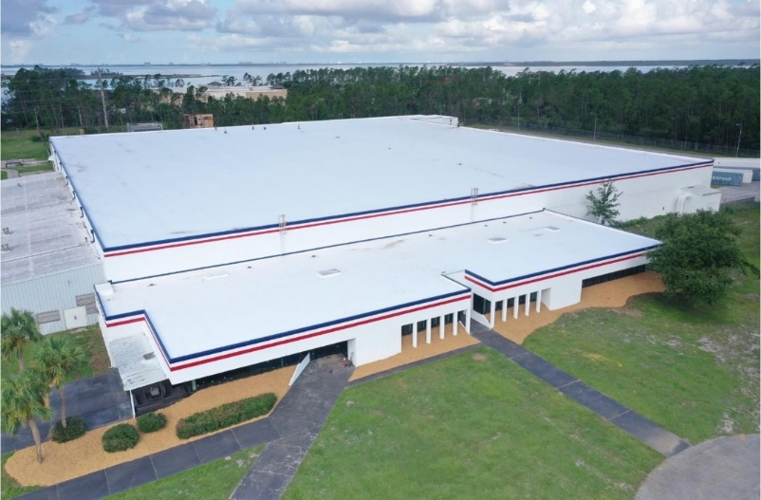

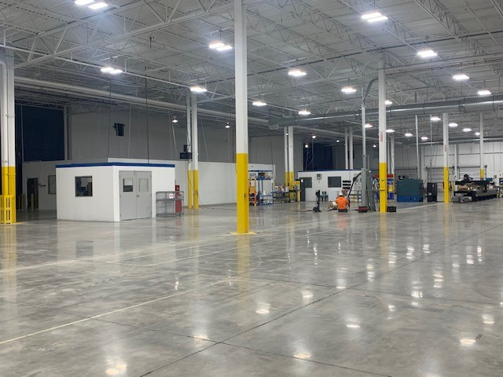
Project Spinner - IAG Aero Group
Bay County, FL Overview
BayEDA.com – 850.215.9965
Notes:
Port Panama City is a growing deep-water port and international gateway, handling a wide variety of cargo, and offers the best shipping connections to Mexico than any other port in the United States. In recent years, the Port has invested over $50 million in new facilities and equipment. Over the next five years, the Port plans to increase its cargo tonnage to an annual level of approximately 2.1 to 2.4 million tons, and has committed to another $35 million in improvements.
Panama City’s location provides a Gulf Coast gateway to shippers and consignees in Georgia, Alabama, Florida, Tennessee and the Carolinas. The Port also serves as trading partners to Mexico, Central America, South America, China, Europe and the Mediterranean. The Port is equipped with modem loading and unloading facilities for truck, rail, barge, container, RO-RO vessel and deep-water vessel traffic.
On-site rail is provided by the Bay Line Railroad, which connects to the Port’s Intermodal Distribution Center, a 240-acre pad-ready inland industrial park featuring a brand new 150,000 square foot distribution warehouse. The Gulf Intracoastal Waterway, a 1,050-mile inland navigable waterway from Carrabelle, FL to Brownsville, TX, is located adjacent to the Port providing access to the Mississippi River and numerous southeastern ports.
Primary General and Bulk Cargos Include:
Forest Products
Copper
Steel
Containerized Cargo
Wood Pellets
Aggregates
Molasses
D-Limonene
Port of Progreso, Mexico has a Sister Port agreement with Port Panama City. The two ports pledged to promote shipping activity and increased commercial opportunities along the corridor. The Port of Progreso is located on Mexico’s Yucatan Peninsula, 575 nautical miles from Port Panama City. Port of Progreso handled about 4.6 million tons of cargo in 2009, and the 160–acre port has almost 8,000 feet of commercial dock space, silos for grain storage and a cruise ship terminal.

Slide 15
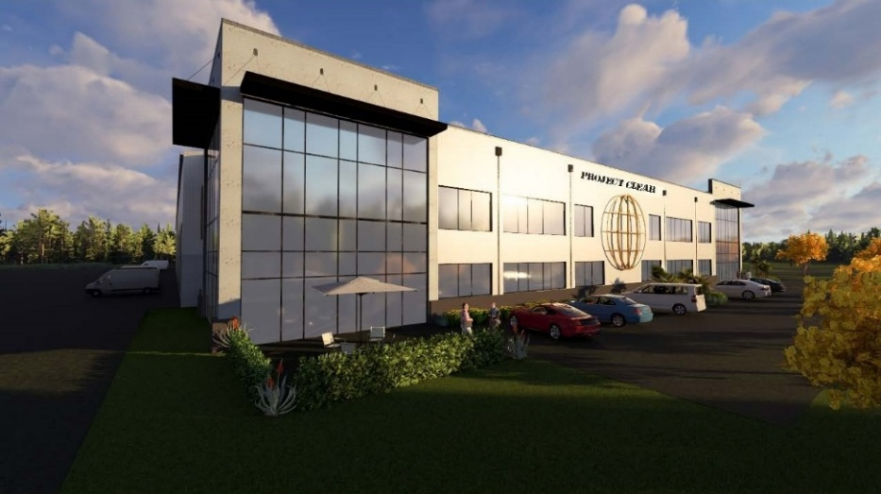
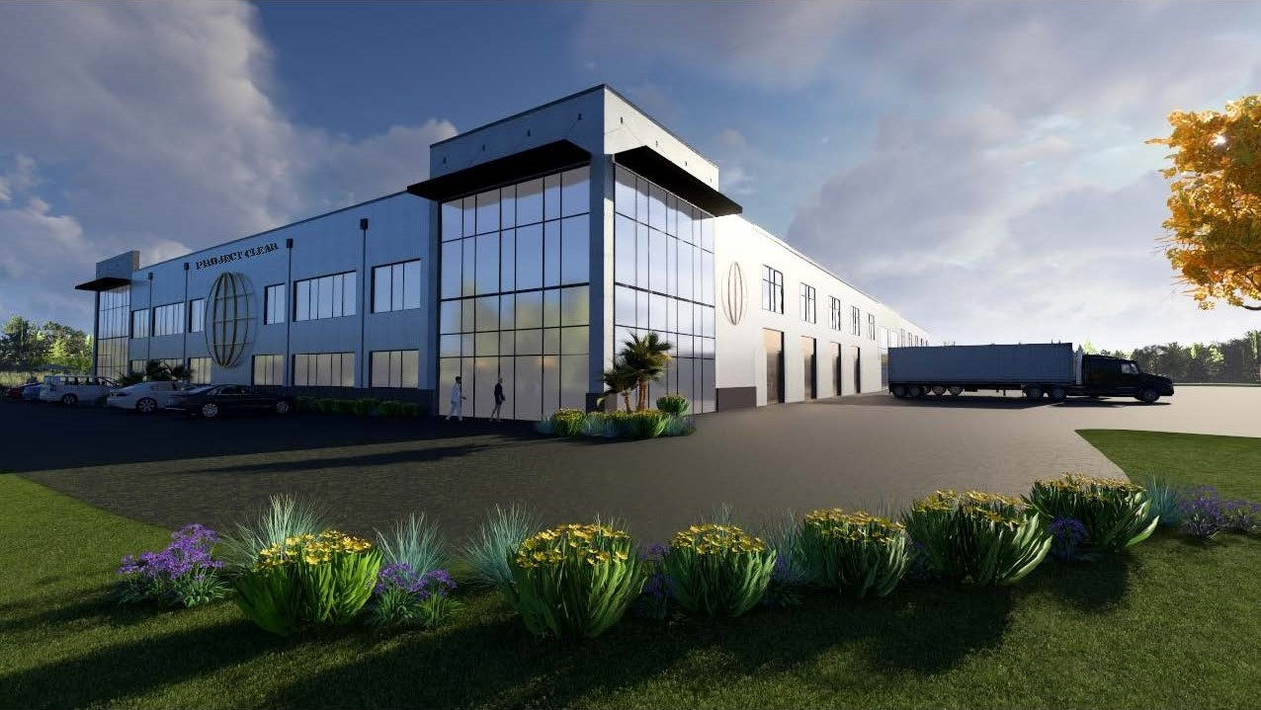

Project Clear - Global Impact Products
Bay County, FL Overview
BayEDA.com – 850.215.9965
Notes:
Port Panama City is a growing deep-water port and international gateway, handling a wide variety of cargo, and offers the best shipping connections to Mexico than any other port in the United States. In recent years, the Port has invested over $50 million in new facilities and equipment. Over the next five years, the Port plans to increase its cargo tonnage to an annual level of approximately 2.1 to 2.4 million tons, and has committed to another $35 million in improvements.
Panama City’s location provides a Gulf Coast gateway to shippers and consignees in Georgia, Alabama, Florida, Tennessee and the Carolinas. The Port also serves as trading partners to Mexico, Central America, South America, China, Europe and the Mediterranean. The Port is equipped with modem loading and unloading facilities for truck, rail, barge, container, RO-RO vessel and deep-water vessel traffic.
On-site rail is provided by the Bay Line Railroad, which connects to the Port’s Intermodal Distribution Center, a 240-acre pad-ready inland industrial park featuring a brand new 150,000 square foot distribution warehouse. The Gulf Intracoastal Waterway, a 1,050-mile inland navigable waterway from Carrabelle, FL to Brownsville, TX, is located adjacent to the Port providing access to the Mississippi River and numerous southeastern ports.
Primary General and Bulk Cargos Include:
Forest Products
Copper
Steel
Containerized Cargo
Wood Pellets
Aggregates
Molasses
D-Limonene
Port of Progreso, Mexico has a Sister Port agreement with Port Panama City. The two ports pledged to promote shipping activity and increased commercial opportunities along the corridor. The Port of Progreso is located on Mexico’s Yucatan Peninsula, 575 nautical miles from Port Panama City. Port of Progreso handled about 4.6 million tons of cargo in 2009, and the 160–acre port has almost 8,000 feet of commercial dock space, silos for grain storage and a cruise ship terminal.

Slide 16
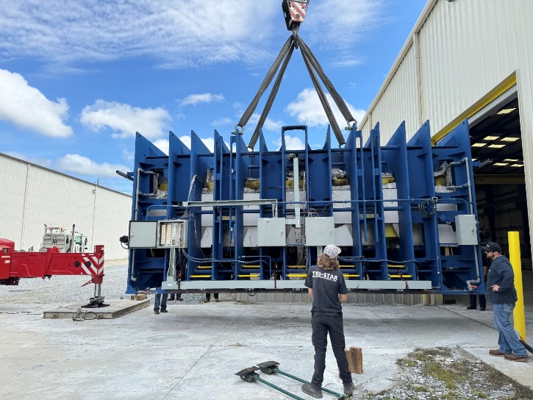
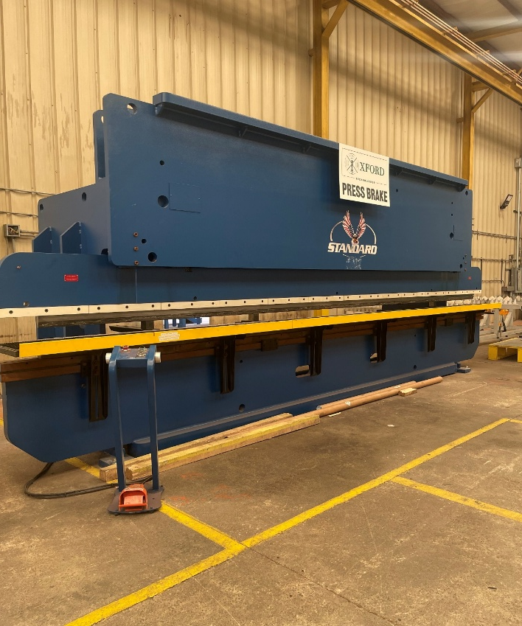
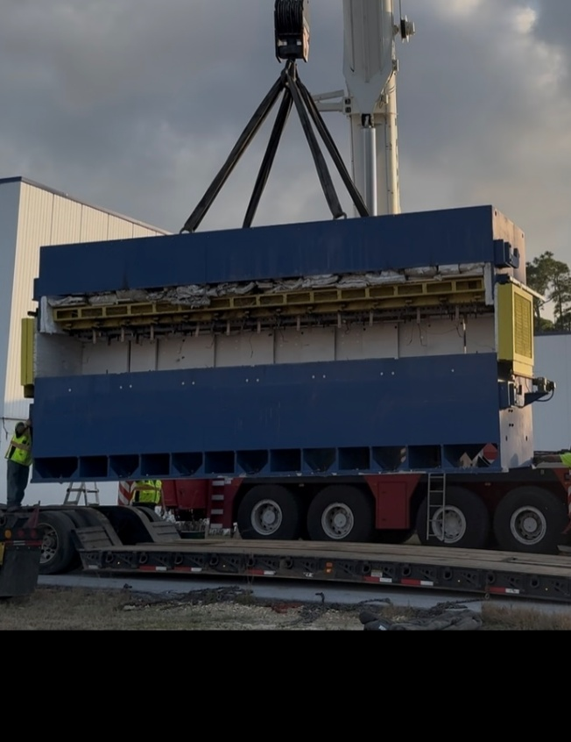
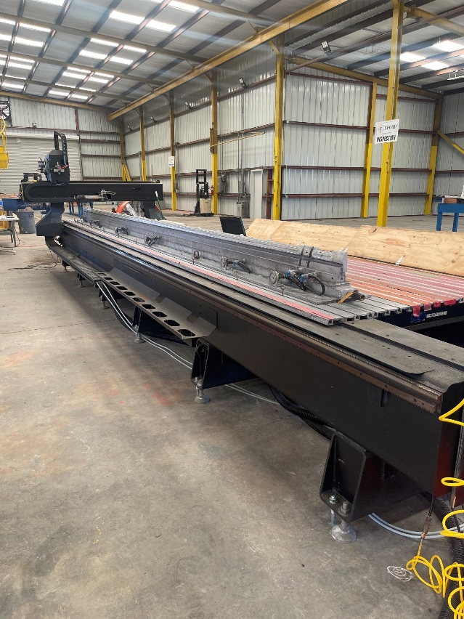
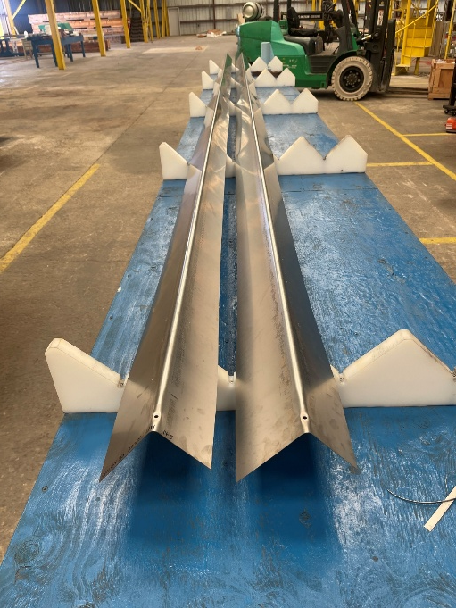

Project Amadeus – Oxford Technologies
Bay County, FL Overview
BayEDA.com – 850.215.9965
Notes:
Port Panama City is a growing deep-water port and international gateway, handling a wide variety of cargo, and offers the best shipping connections to Mexico than any other port in the United States. In recent years, the Port has invested over $50 million in new facilities and equipment. Over the next five years, the Port plans to increase its cargo tonnage to an annual level of approximately 2.1 to 2.4 million tons, and has committed to another $35 million in improvements.
Panama City’s location provides a Gulf Coast gateway to shippers and consignees in Georgia, Alabama, Florida, Tennessee and the Carolinas. The Port also serves as trading partners to Mexico, Central America, South America, China, Europe and the Mediterranean. The Port is equipped with modem loading and unloading facilities for truck, rail, barge, container, RO-RO vessel and deep-water vessel traffic.
On-site rail is provided by the Bay Line Railroad, which connects to the Port’s Intermodal Distribution Center, a 240-acre pad-ready inland industrial park featuring a brand new 150,000 square foot distribution warehouse. The Gulf Intracoastal Waterway, a 1,050-mile inland navigable waterway from Carrabelle, FL to Brownsville, TX, is located adjacent to the Port providing access to the Mississippi River and numerous southeastern ports.
Primary General and Bulk Cargos Include:
Forest Products
Copper
Steel
Containerized Cargo
Wood Pellets
Aggregates
Molasses
D-Limonene
Port of Progreso, Mexico has a Sister Port agreement with Port Panama City. The two ports pledged to promote shipping activity and increased commercial opportunities along the corridor. The Port of Progreso is located on Mexico’s Yucatan Peninsula, 575 nautical miles from Port Panama City. Port of Progreso handled about 4.6 million tons of cargo in 2009, and the 160–acre port has almost 8,000 feet of commercial dock space, silos for grain storage and a cruise ship terminal.

Slide 17

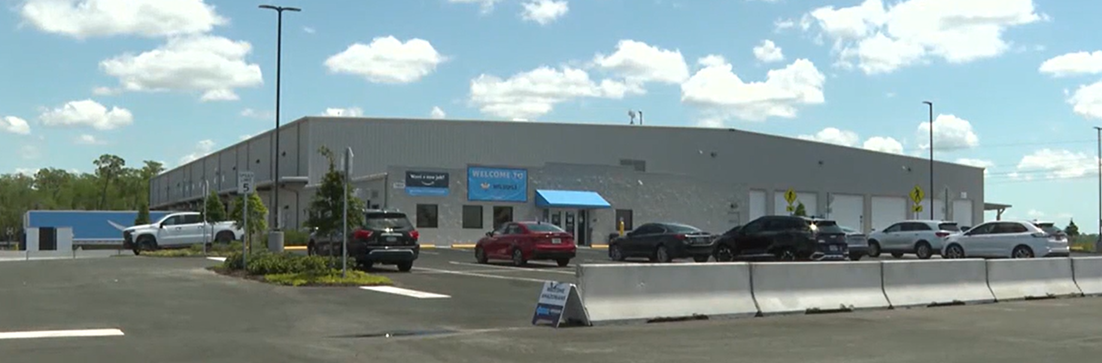
Project Rainforest – Amazon
Bay County, FL Overview
BayEDA.com – 850.215.9965
Notes:
Port Panama City is a growing deep-water port and international gateway, handling a wide variety of cargo, and offers the best shipping connections to Mexico than any other port in the United States. In recent years, the Port has invested over $50 million in new facilities and equipment. Over the next five years, the Port plans to increase its cargo tonnage to an annual level of approximately 2.1 to 2.4 million tons, and has committed to another $35 million in improvements.
Panama City’s location provides a Gulf Coast gateway to shippers and consignees in Georgia, Alabama, Florida, Tennessee and the Carolinas. The Port also serves as trading partners to Mexico, Central America, South America, China, Europe and the Mediterranean. The Port is equipped with modem loading and unloading facilities for truck, rail, barge, container, RO-RO vessel and deep-water vessel traffic.
On-site rail is provided by the Bay Line Railroad, which connects to the Port’s Intermodal Distribution Center, a 240-acre pad-ready inland industrial park featuring a brand new 150,000 square foot distribution warehouse. The Gulf Intracoastal Waterway, a 1,050-mile inland navigable waterway from Carrabelle, FL to Brownsville, TX, is located adjacent to the Port providing access to the Mississippi River and numerous southeastern ports.
Primary General and Bulk Cargos Include:
Forest Products
Copper
Steel
Containerized Cargo
Wood Pellets
Aggregates
Molasses
D-Limonene
Port of Progreso, Mexico has a Sister Port agreement with Port Panama City. The two ports pledged to promote shipping activity and increased commercial opportunities along the corridor. The Port of Progreso is located on Mexico’s Yucatan Peninsula, 575 nautical miles from Port Panama City. Port of Progreso handled about 4.6 million tons of cargo in 2009, and the 160–acre port has almost 8,000 feet of commercial dock space, silos for grain storage and a cruise ship terminal.

Slide 18

Bay County, FL Overview
BayEDA.com – 850.215.9965
Notes:
Port Panama City is a growing deep-water port and international gateway, handling a wide variety of cargo, and offers the best shipping connections to Mexico than any other port in the United States. In recent years, the Port has invested over $50 million in new facilities and equipment. Over the next five years, the Port plans to increase its cargo tonnage to an annual level of approximately 2.1 to 2.4 million tons, and has committed to another $35 million in improvements.
Panama City’s location provides a Gulf Coast gateway to shippers and consignees in Georgia, Alabama, Florida, Tennessee and the Carolinas. The Port also serves as trading partners to Mexico, Central America, South America, China, Europe and the Mediterranean. The Port is equipped with modem loading and unloading facilities for truck, rail, barge, container, RO-RO vessel and deep-water vessel traffic.
On-site rail is provided by the Bay Line Railroad, which connects to the Port’s Intermodal Distribution Center, a 240-acre pad-ready inland industrial park featuring a brand new 150,000 square foot distribution warehouse. The Gulf Intracoastal Waterway, a 1,050-mile inland navigable waterway from Carrabelle, FL to Brownsville, TX, is located adjacent to the Port providing access to the Mississippi River and numerous southeastern ports.
Primary General and Bulk Cargos Include:
Forest Products
Copper
Steel
Containerized Cargo
Wood Pellets
Aggregates
Molasses
D-Limonene
Port of Progreso, Mexico has a Sister Port agreement with Port Panama City. The two ports pledged to promote shipping activity and increased commercial opportunities along the corridor. The Port of Progreso is located on Mexico’s Yucatan Peninsula, 575 nautical miles from Port Panama City. Port of Progreso handled about 4.6 million tons of cargo in 2009, and the 160–acre port has almost 8,000 feet of commercial dock space, silos for grain storage and a cruise ship terminal.

Slide 19




4 New Company Announcements in 2025
IAG Aero Group
Oxford Technologies Corporation
Global Impact Products
Amazon Last Mile Delivery Station
4 new Project Announcements
750 jobs
$138M CapEX
Bay County, FL Overview
BayEDA.com – 850.215.9965

Slide 20

Total Economic Impact
4 NEW PROJECT ANNOUNCMENTS
2,048 JOBS
$120M
ANNUAL WAGES
$233M
TOTAL
VALUE ADDED
*Economic Impact Studies conducted by our partners at Florida Power & Light.
Bay County, FL Overview
BayEDA.com – 850.215.9965

Slide 21
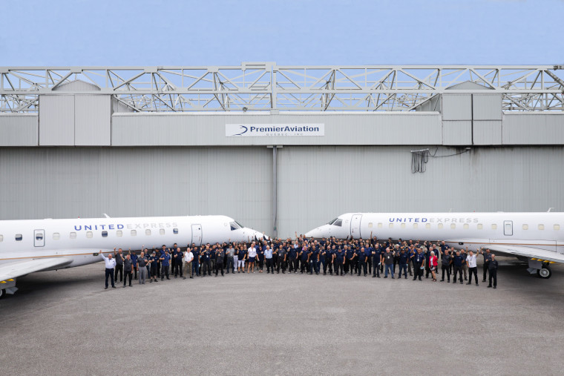
Project Maple – Premier Aviation
Bay County, FL Overview
BayEDA.com – 850.215.9965
Notes:
Port Panama City is a growing deep-water port and international gateway, handling a wide variety of cargo, and offers the best shipping connections to Mexico than any other port in the United States. In recent years, the Port has invested over $50 million in new facilities and equipment. Over the next five years, the Port plans to increase its cargo tonnage to an annual level of approximately 2.1 to 2.4 million tons, and has committed to another $35 million in improvements.
Panama City’s location provides a Gulf Coast gateway to shippers and consignees in Georgia, Alabama, Florida, Tennessee and the Carolinas. The Port also serves as trading partners to Mexico, Central America, South America, China, Europe and the Mediterranean. The Port is equipped with modem loading and unloading facilities for truck, rail, barge, container, RO-RO vessel and deep-water vessel traffic.
On-site rail is provided by the Bay Line Railroad, which connects to the Port’s Intermodal Distribution Center, a 240-acre pad-ready inland industrial park featuring a brand new 150,000 square foot distribution warehouse. The Gulf Intracoastal Waterway, a 1,050-mile inland navigable waterway from Carrabelle, FL to Brownsville, TX, is located adjacent to the Port providing access to the Mississippi River and numerous southeastern ports.
Primary General and Bulk Cargos Include:
Forest Products
Copper
Steel
Containerized Cargo
Wood Pellets
Aggregates
Molasses
D-Limonene
Port of Progreso, Mexico has a Sister Port agreement with Port Panama City. The two ports pledged to promote shipping activity and increased commercial opportunities along the corridor. The Port of Progreso is located on Mexico’s Yucatan Peninsula, 575 nautical miles from Port Panama City. Port of Progreso handled about 4.6 million tons of cargo in 2009, and the 160–acre port has almost 8,000 feet of commercial dock space, silos for grain storage and a cruise ship terminal.

Slide 22
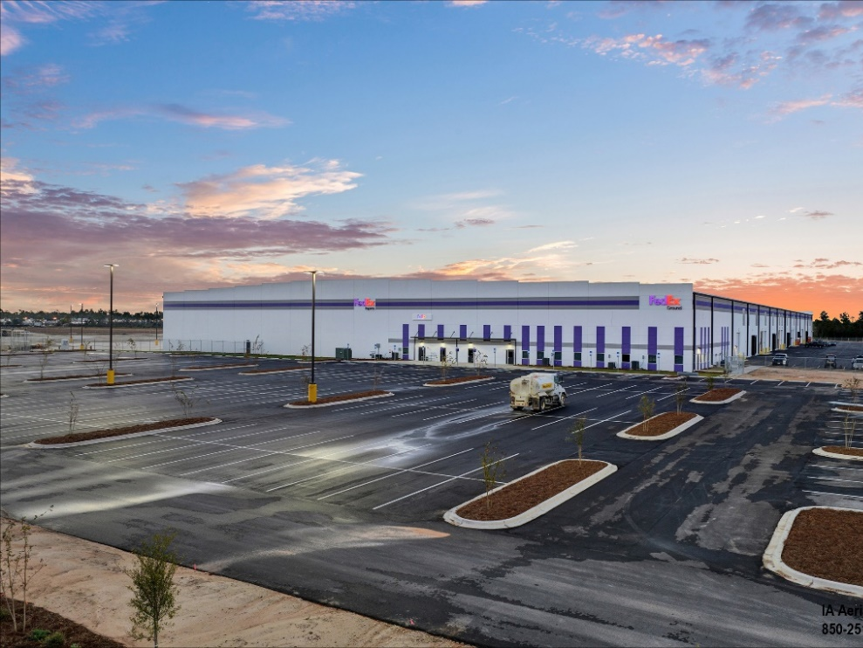

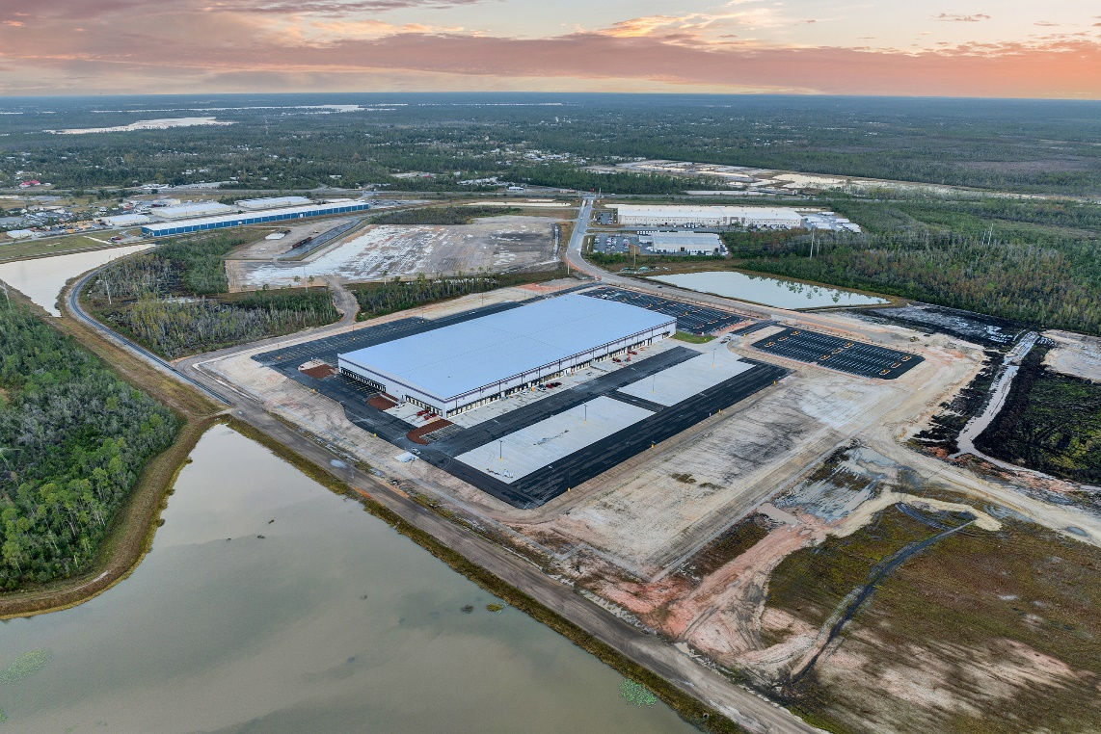
Project Rocket – FedEx Ground
Bay County, FL Overview
BayEDA.com – 850.215.9965

Slide 23
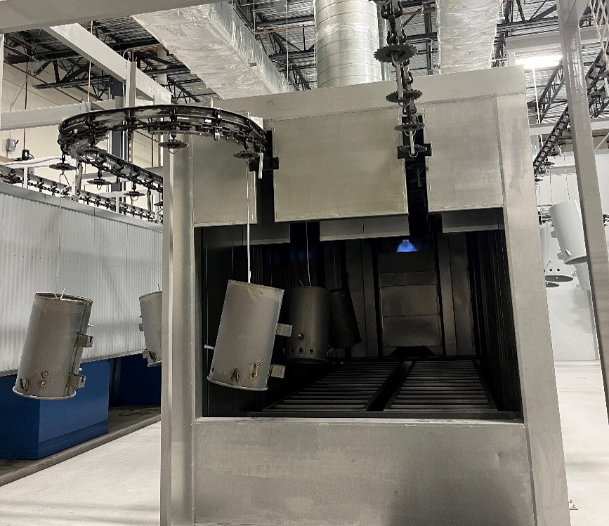
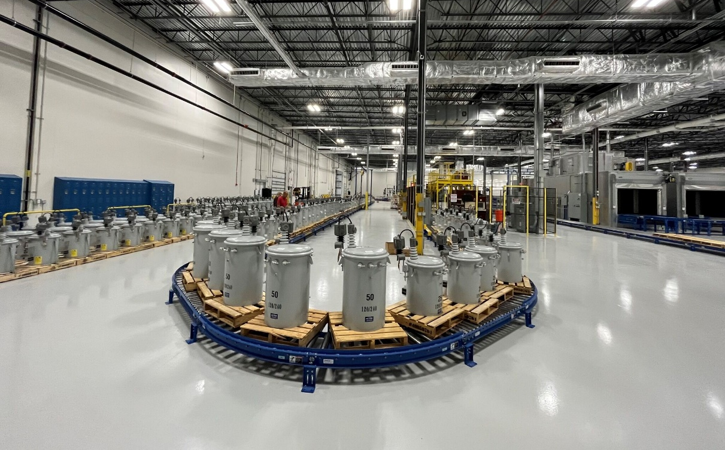

Project Lightning Strike – Central Moloney
Bay County, FL Overview
BayEDA.com – 850.215.9965

Slide 24
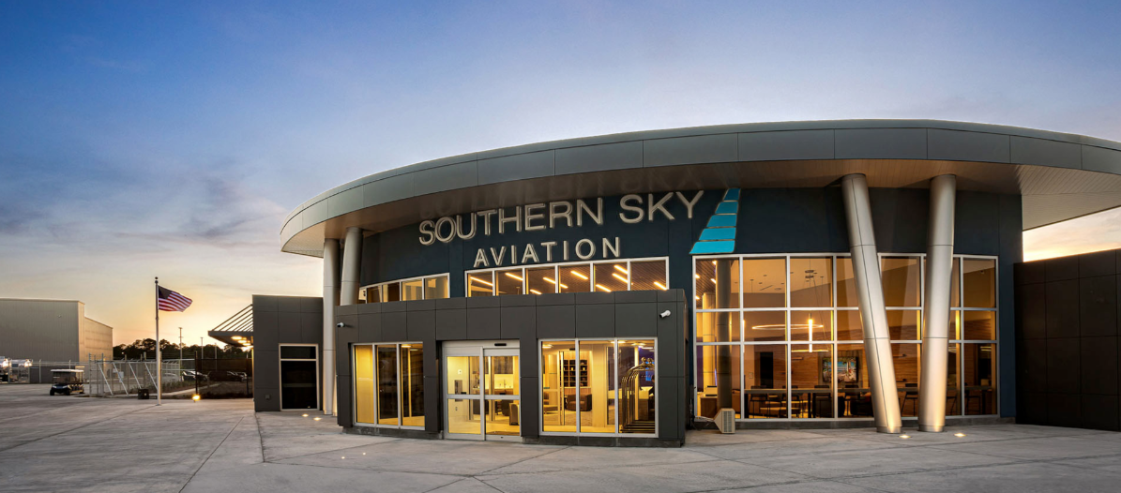


Project Tiger – Southern Sky Aviation
Terminal and Hangars are Complete
Open and Operational
30 Employees
$35M Capital Investment
Bay County, FL Overview
BayEDA.com – 850.215.9965

Slide 25
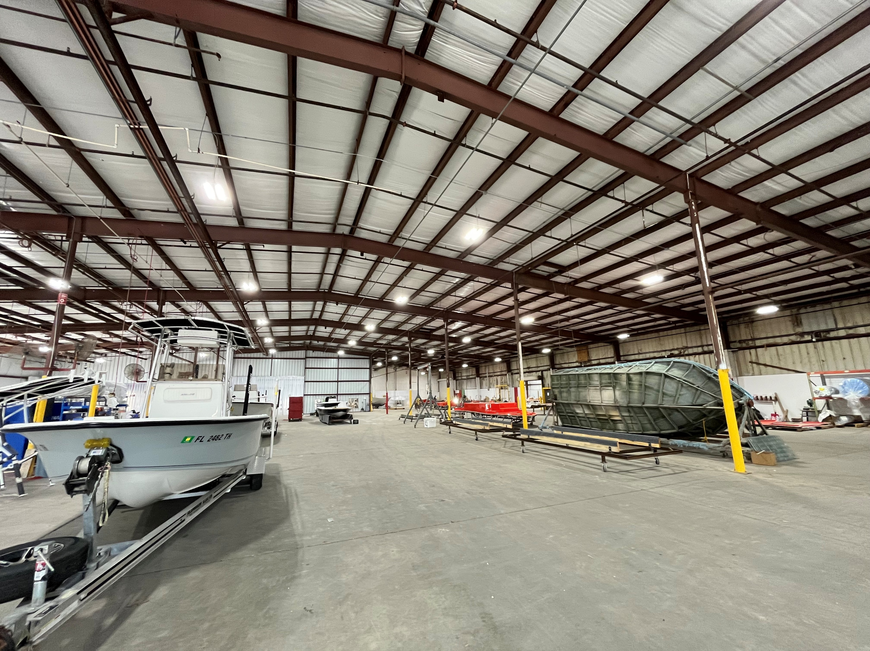
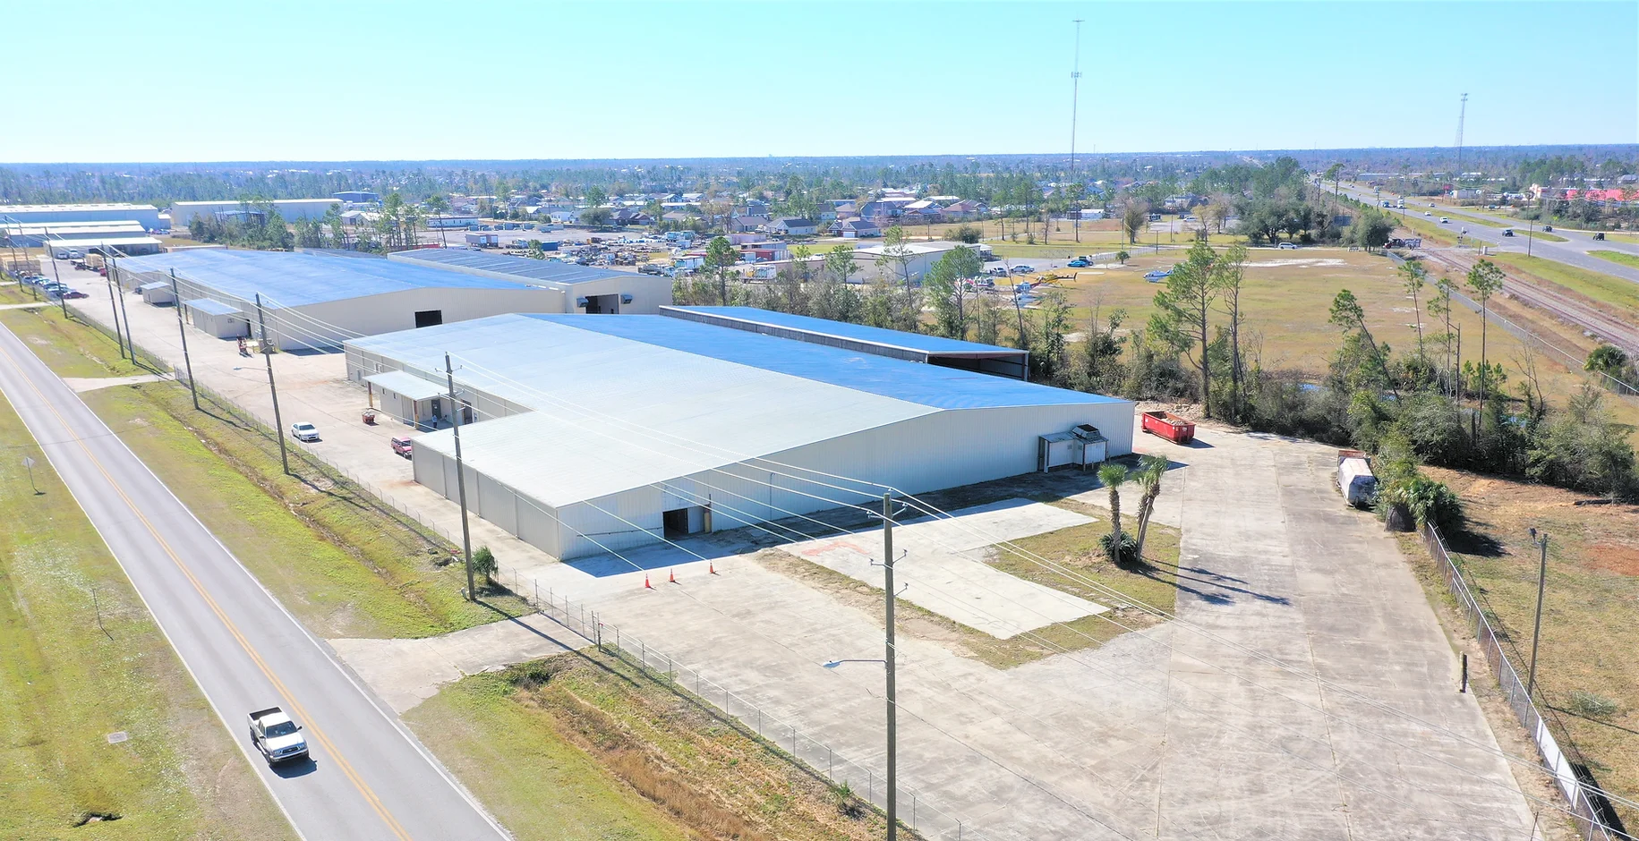
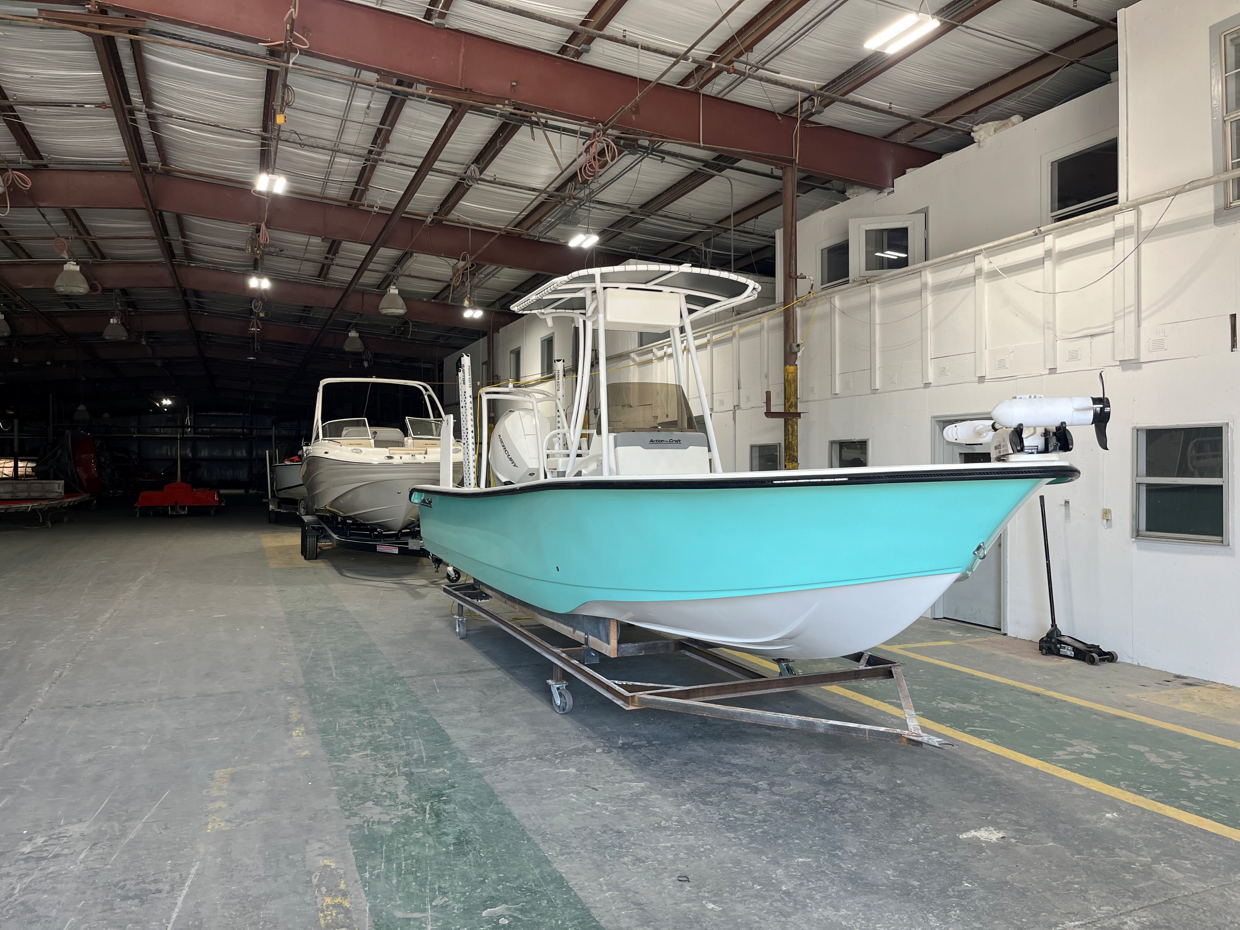
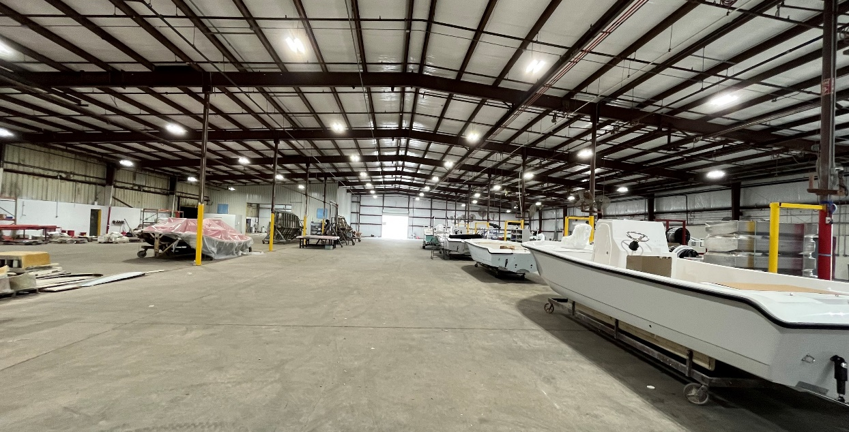

Project Cast – Mocama Marine
Bay County, FL Overview
BayEDA.com – 850.215.9965

Slide 26
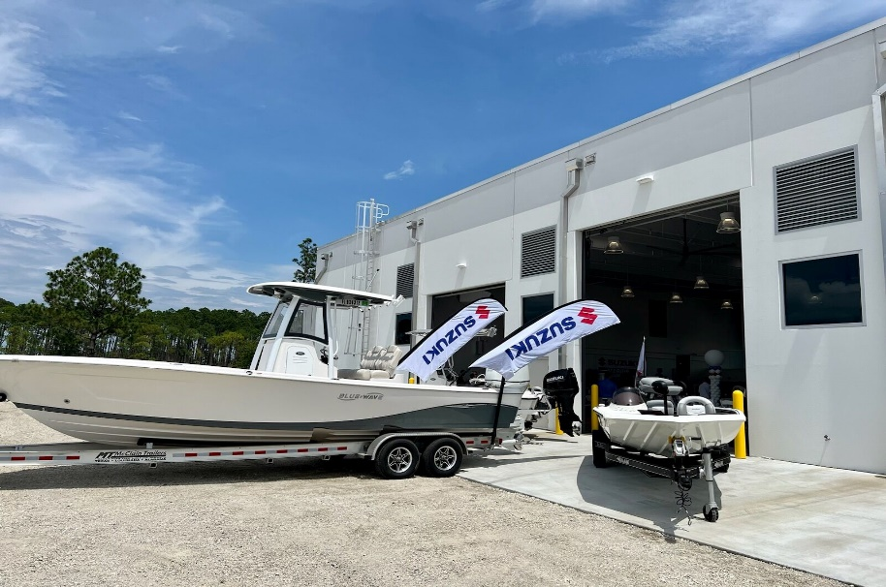
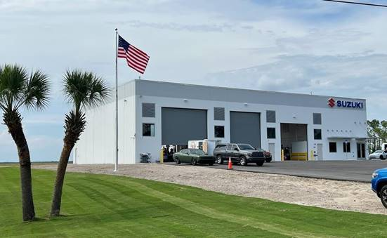
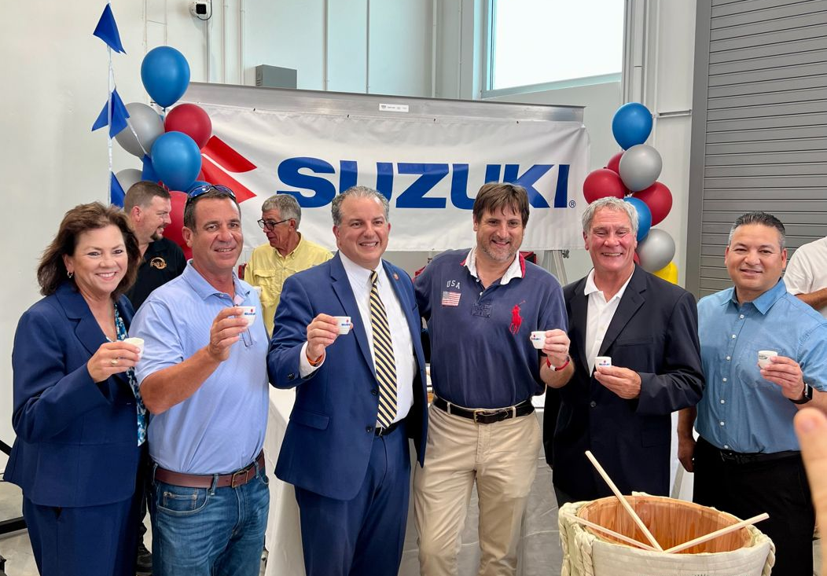
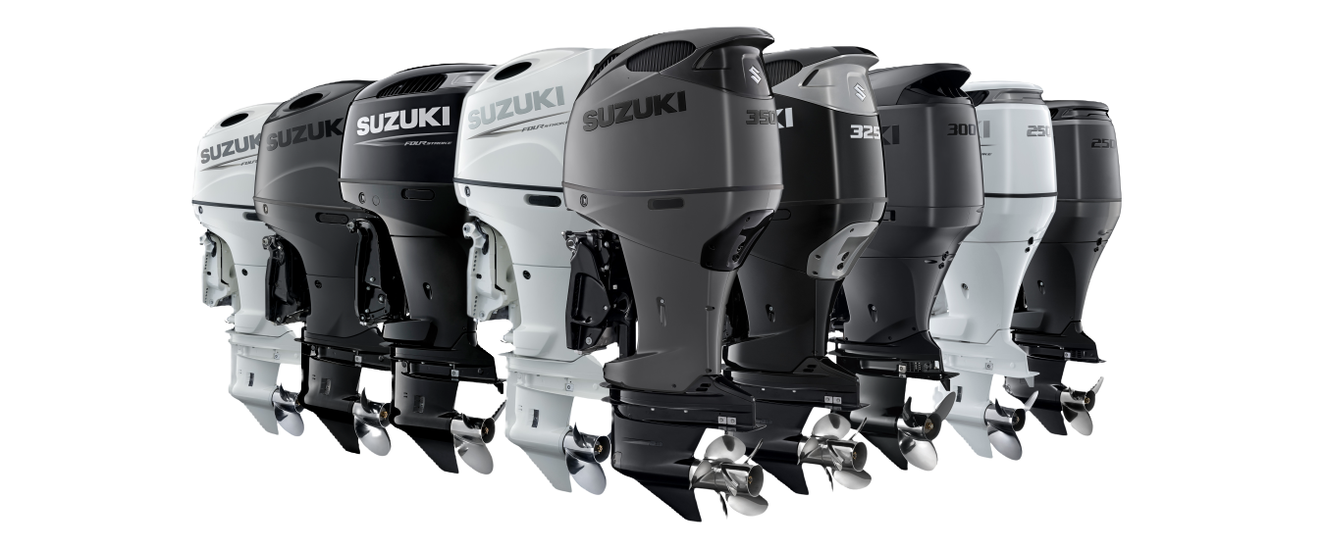

Suzuki Motor Marine Technical Center
Bay County, FL Overview
BayEDA.com – 850.215.9965

Slide 27


Focus on the Future and Continued Growth
MRO / Aviation & Marine “cluster” recruitment
Create the “InSPIRE” Aviation Center of Excellence partnership FSU and Haney Technical College
Enhance export/import/distribution activities with the Yucatan of Mexico
Identification of potential future industrial parks
Continued implementation of “creative” ways to organically grow our workforce of the future
Continued development of strategies to recruit international and domestic companies
Bay County, FL Overview
BayEDA.com – 850.215.9965

Slide 28
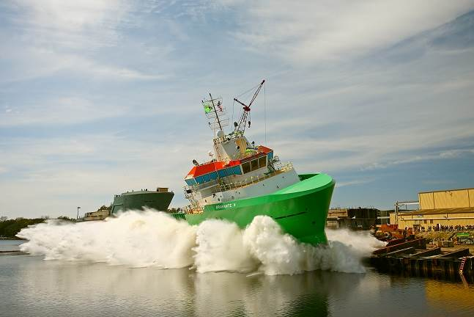
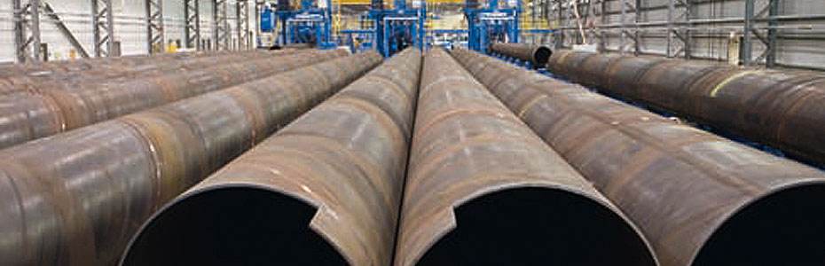
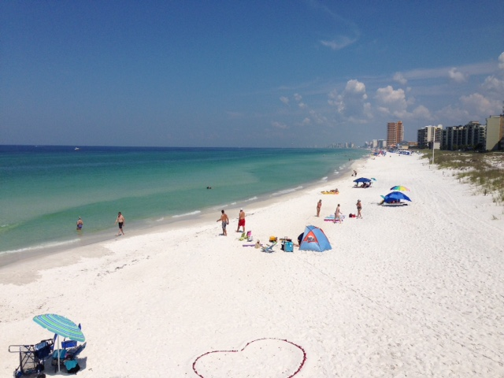

Work Hard – Play Harder!
CPAR Commercial
January 27th, 2026

Slide 29
Kurt Fadden
2026 Commercial
Committee Chair

Slide 30


Slide 31


